Slide 1
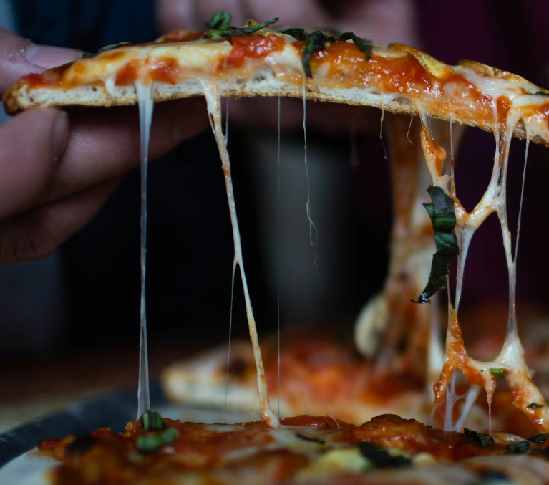
Mario and Luigi Pizzeria
Group N5
Nikita Monogarov
Geogri Fidanov
Franklin Bakhuis
Ivan Slavov

Slide 2
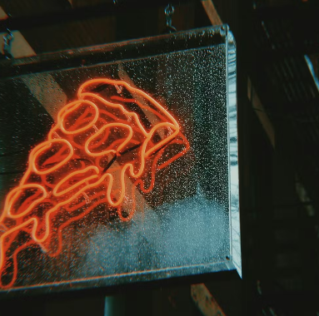
Introduction to The Project:
Problem: Lack of communication
Goal: Provide the solution to improve communication between employees and customers

Slide 3
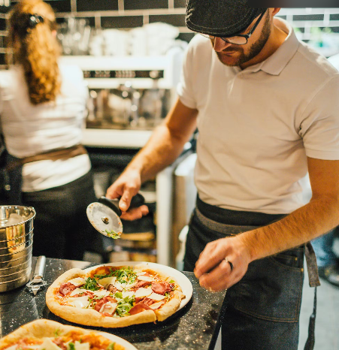
Solution
Web application with:
User-friendly interface
Datebase
Real-time order tracking
Login and Recovery page
Easy order tracking for admins
Smart oven buzzer system

Slide 4
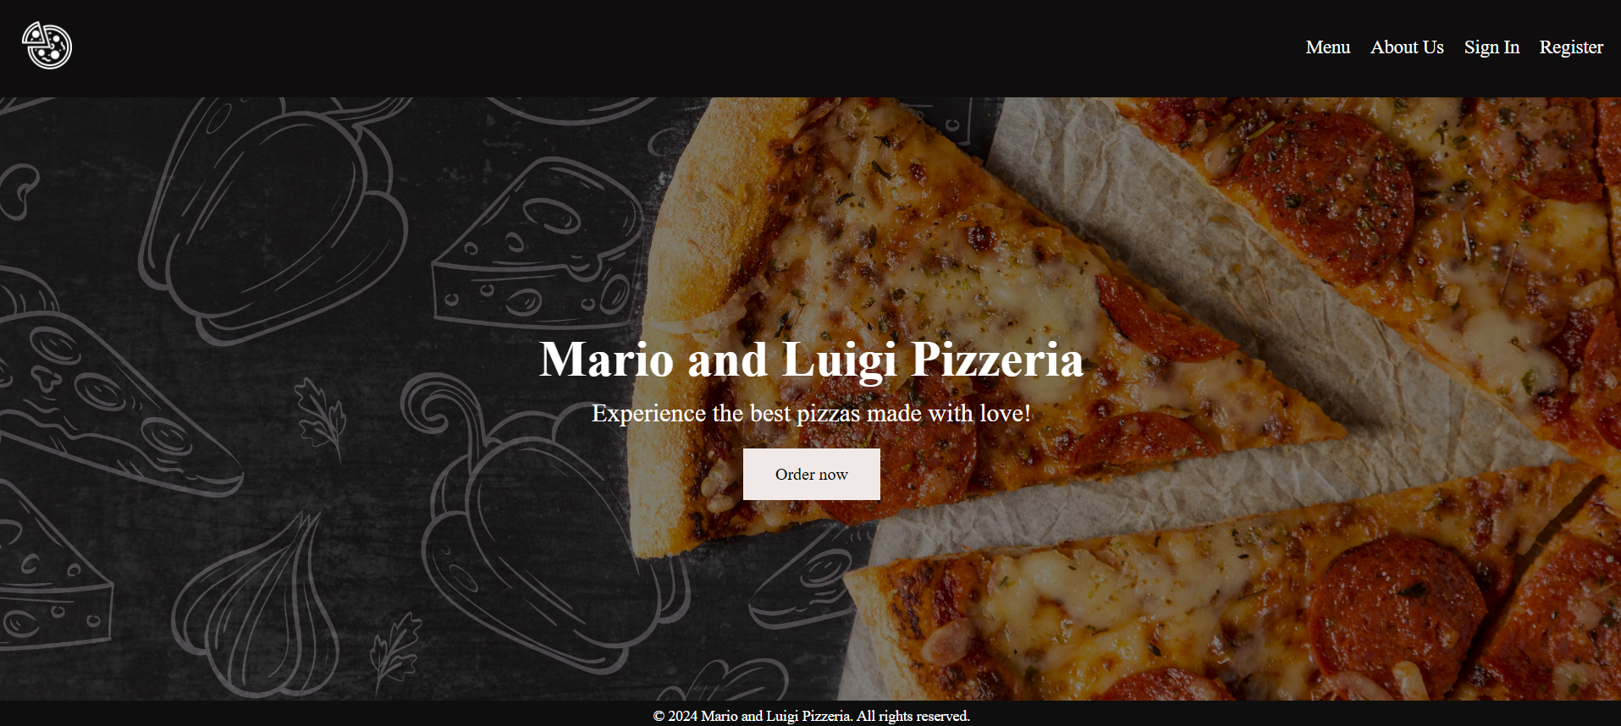
TIME FOR A DEMO

Slide 5
Why is our product the solution
All requirements met with extra features that will take it to the next level
Centralized Dashboard for Easy Management: Admins can easily track orders and manage key system activities and have easier ways to communicate when orders are ready
Intuitive and User-Friendly: Designed for all experience levels, our product is easy to learn and use

Slide 6
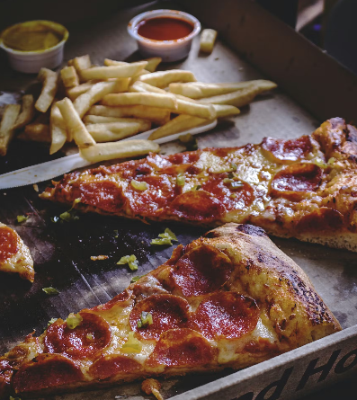
Lookback
Group Reflection: What did we learn together?

Slide 7

Thank you!

